Slide 1

Goal-Directed Design Methodology
Week 11
CS411 - Human Computer Interface

Slide 2
Last Lecture
Software & HCI Lifecycle Models
Goal-Directed Design Model

Slide 3
Today’s Lecture
Goal-Directed Design Model
Goal-Directed Design Methodology

Slide 4
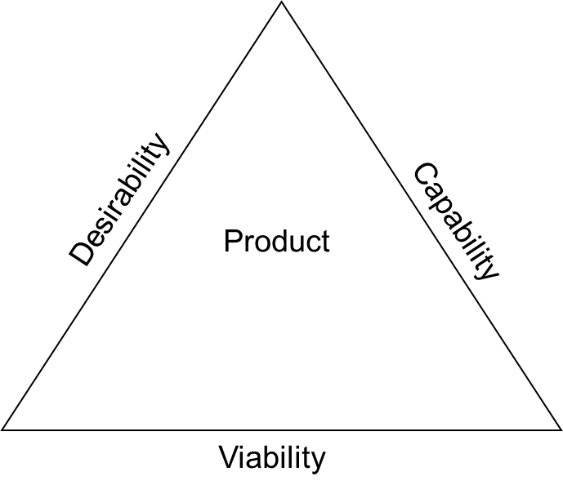
Success Factors for a Product

Slide 5
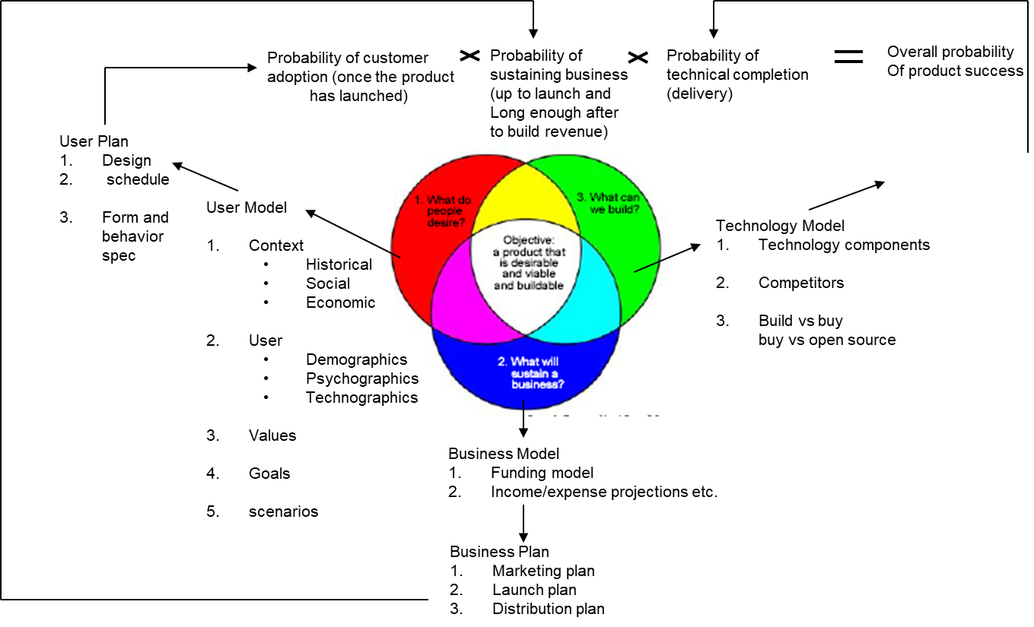
Success Factors for a Product

Slide 6
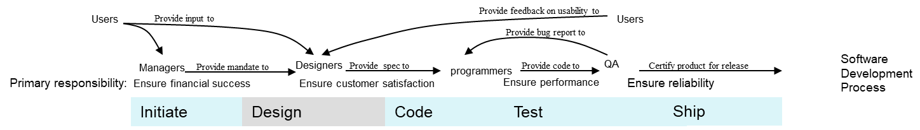
The Software Development Process

Slide 7
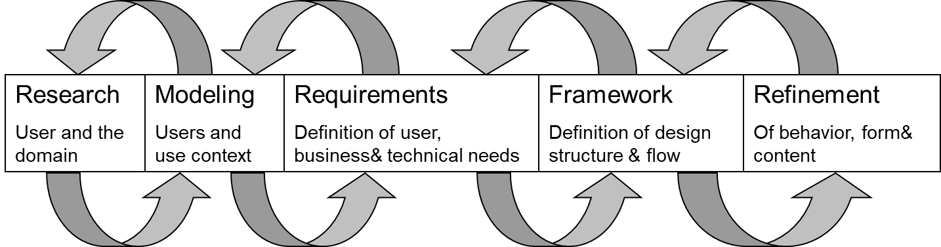
Goal-directed Design Model

Slide 8
Goal-Directed Design Approach
It provides solutions that meet
The needs and goals of users
Business/organizational and
Technical imperatives.

Slide 9
Goal-Directed Design Approach
combines techniques of
Ethnography
Stakeholder interviews
Market research
Product/literature reviews
Detailed user model
Scenario-based design and a core set of interaction principles and patterns.

Slide 10
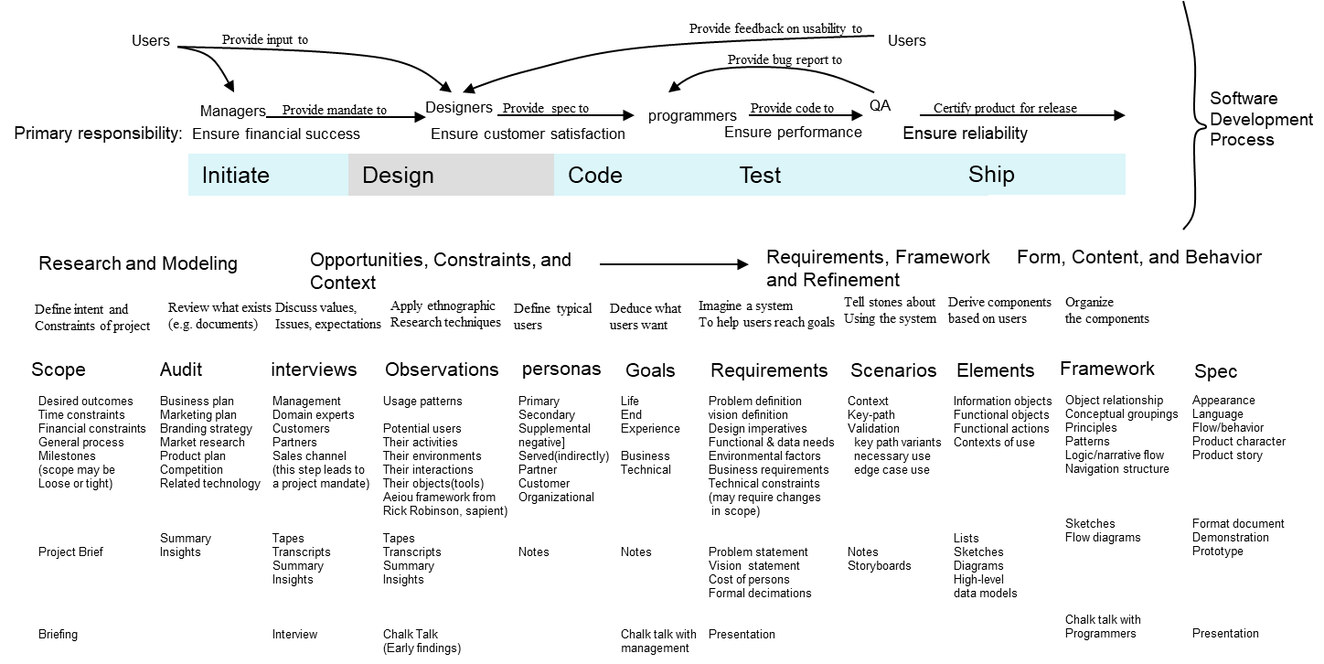
Goal-directed Design

Slide 11
Research
Employs ethnographic field study techniques.
observation and contextual interviews
Provide qualitative data about potential and/or actual users.
Includes competitive product audits, reviews of market research and technology.

Slide 12
Modeling
Usage patterns are used to build models
Domain model
User model

Slide 13
Requirement
We gather
User needs
Business needs
Technical needs
We use scenario to see how the design can meet goals and needs of specific personas

Slide 14
Framework
Define design structure and flow
Interaction design principles and interaction design patterns are used to define interaction framework

Slide 15
Refinement
Forms, content and behaviors are prepared
Scenarios are used which shows the usage of product
Key path scenario
Validation scenario
Various specification which shows the form and behavior of product are build.

Slide 16
Goal-directed Design Methodology
Goal-directed Design

Slide 17
Design Group Practices/Standards
Team structure and collaboration
Does not have Subjective opinion
Commitment to evolve and enhance process

Slide 18
Designer Talent and Skills
Imagination
Conceptual skills
Visual skills
Written skills
Verbal skills
Empathy
Interpersonal skills
Brainstorming skills
Analytical skills
Consulting skills

Slide 19
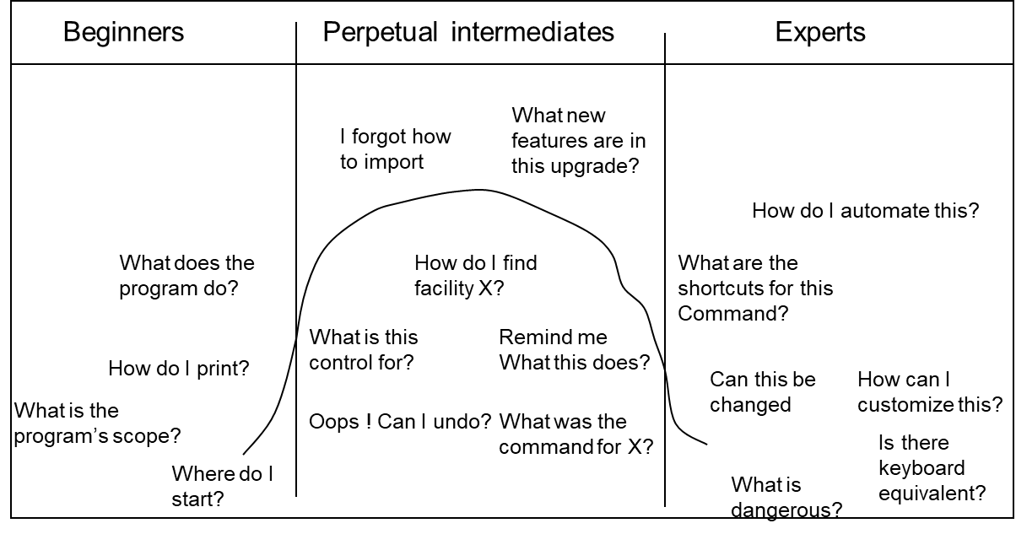
Types of Users

Slide 20
Beginners
Nobody wants to remain a beginner
Make them understand cause and effect
Represented model should follow mental model
Guided tours (overviews) instead of references

Slide 21
Intermediates
Most users are intermediates
Nobody wants to remain a beginner
Programmers are experts
Sales people are beginners and lobby for product training
Optimize for intermediates
Need tool tips, can use reference material

Slide 22
Experts
Experts influence other buyers
Internalize the working of interfaces
Memorize functions due to frequency of use

